Slide 1
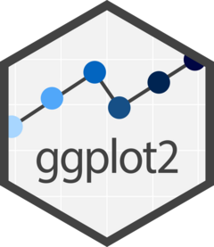
Lauren Nichols
MIDS Workshop
September 2023
Notes:
-first step is deciding if ggplot is the right tool
-Brief overview of the strengths and weaknesses of ggplot
-basic grammar
-how to approach making figures in ggplot

Slide 2
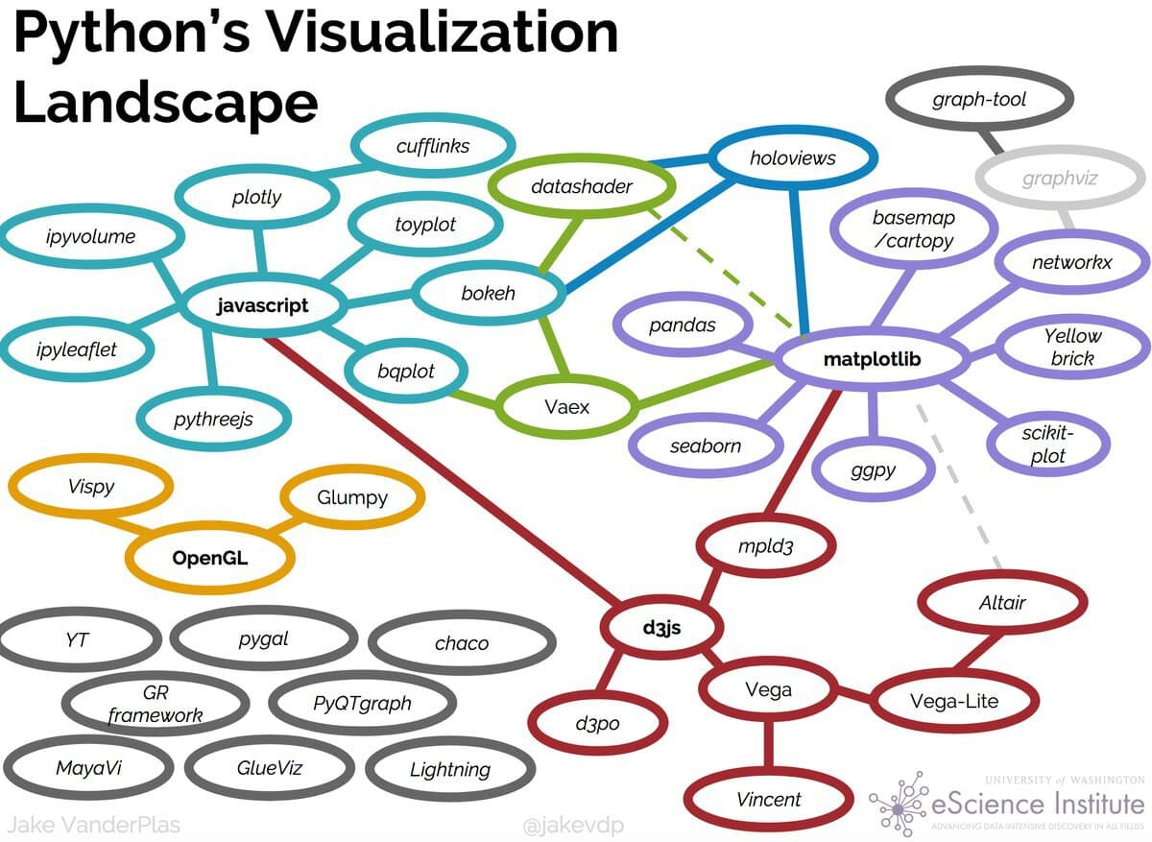

Slide 3

leaflet
r2d3

Slide 4
Strengths
Integration with analysis in R
Based on Grammar of Graphics
Declarative
Succinct
Versatile
Publication ready graphics
(or at least pretty close to it)

Slide 5
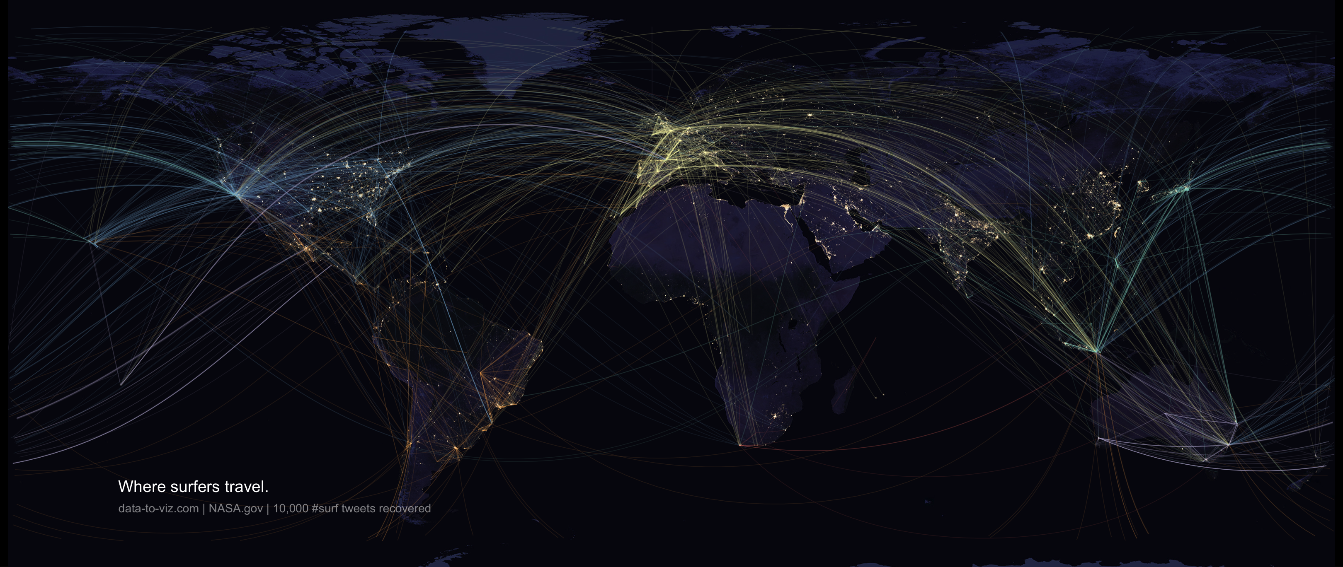

Slide 6
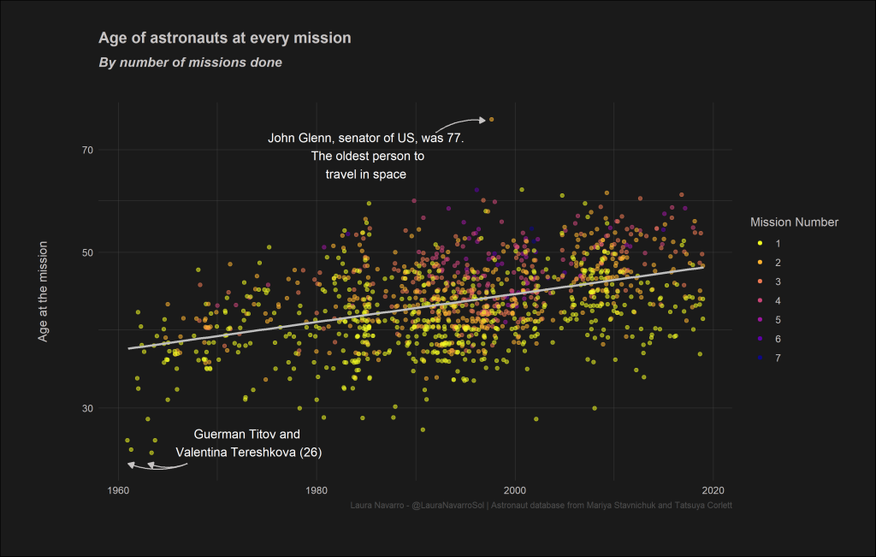

Slide 7
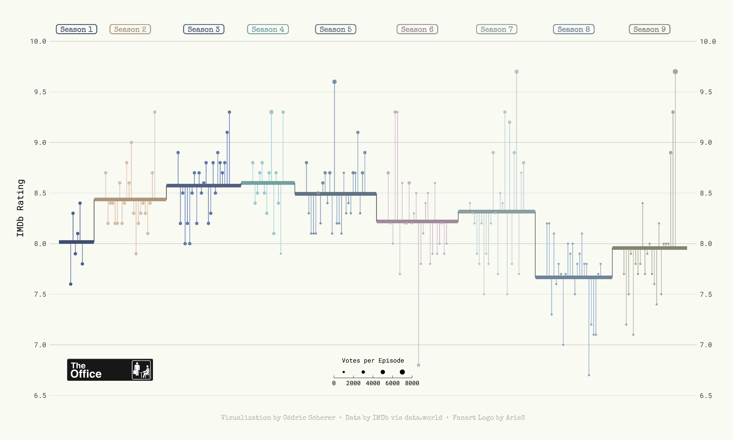

Slide 8
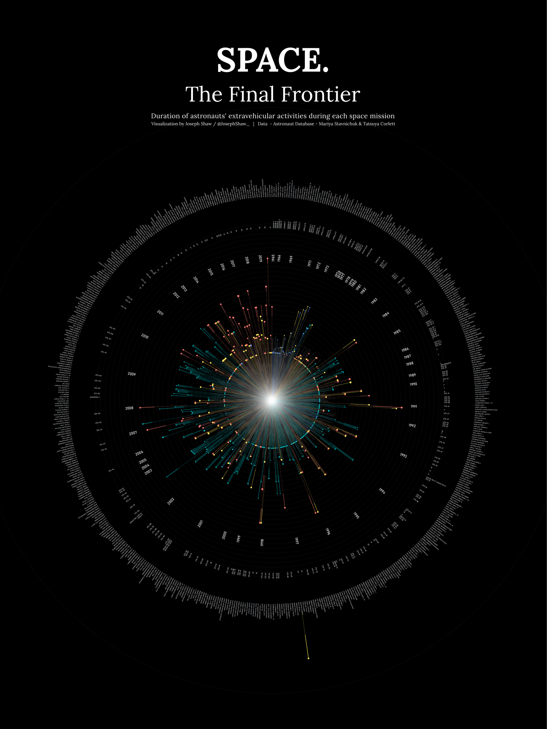
github.com/joseph-shaw/tidytuesday/

Slide 9
github.com/joseph-shaw/tidytuesday/

Slide 10
Strengths
Weaknesses
Integration with analysis in R
Based on Grammar of Graphics
Declarative
Succinct
Versatile
Publication ready graphics
(or at least pretty close to it)
Not practical if you’re working in another language
Interactivity not well supported

Slide 11
Strengths
Weaknesses
Integration with analysis in R
Based on Grammar of Graphics
Declarative
Succinct
Versatile
Publication ready graphics
(or at least pretty close to it)
Not practical if you’re working in another language
Interactivity not well supported
But what about Shiny?!

Slide 13
Data
Aesthetics
Geometries
Statistics
Facets
Themes
Exporting

Slide 14
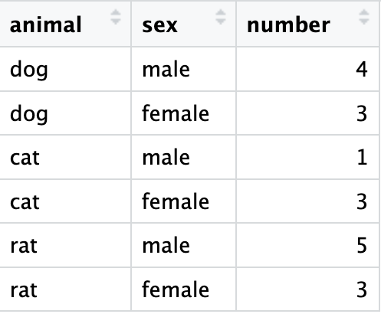
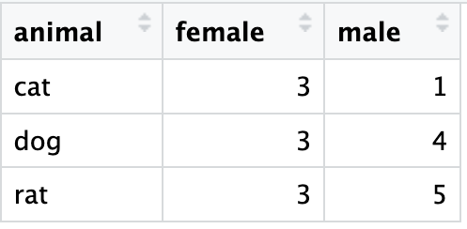
Data Format
Long data
Wide data

Slide 15
Data Format
Long data
Wide data
Wide_data = spread(Long_data, sex, number)

Slide 16
Data Format
Long data
Wide data
Long_data = gather(wide_data , sex, number, female:male)

Slide 17
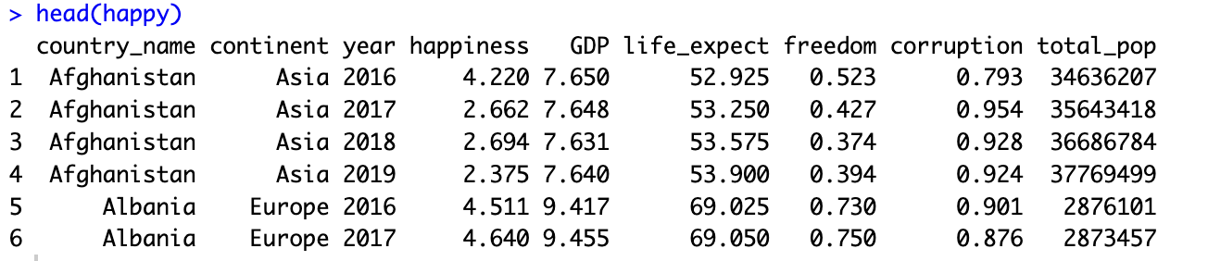

Slide 18
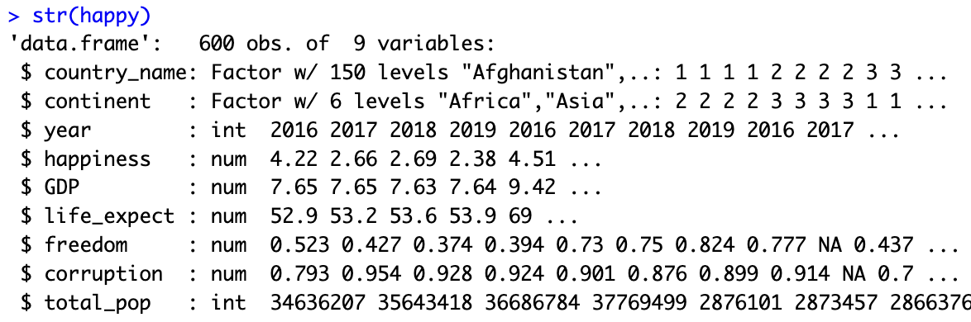

Slide 19
ggplot(data = ,
mapping = aes(x= , ,y= ))+
your data
x axis
y axis
Data
geometry function
Aesthetics
Geometries
Statistics
Facets
Themes
Exporting
Notes:
method chaining with a +

Slide 20
ggplot(data = ,
mapping = aes(x= , ,y= ))+
your data
x axis
y axis
Data
geometry function
Aesthetics
Geometries
ggplot(data = ,
mapping = aes(x= , ,y= ))+
happy
happiness
GDP
Statistics
geom_point()
Facets
Themes
Exporting
Notes:
method chaining with a +

Slide 21
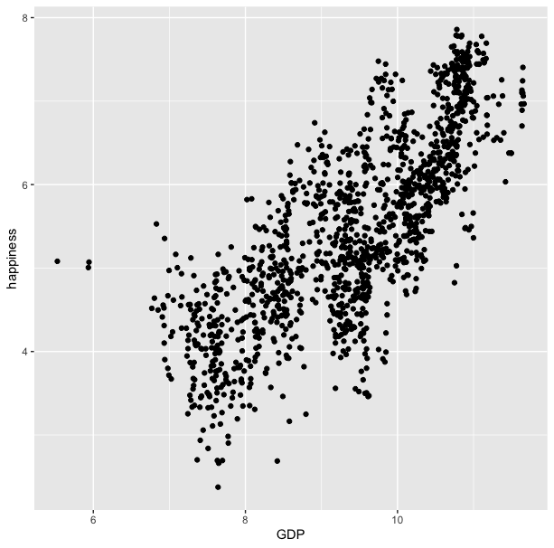
ggplot(data = happy, aes(x=GDP, y=happiness))+
geom_point()

Slide 22
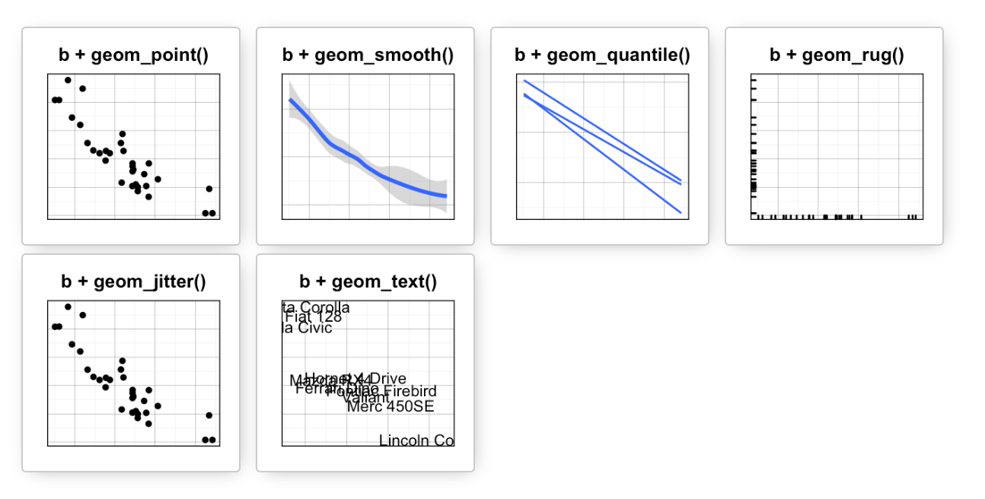
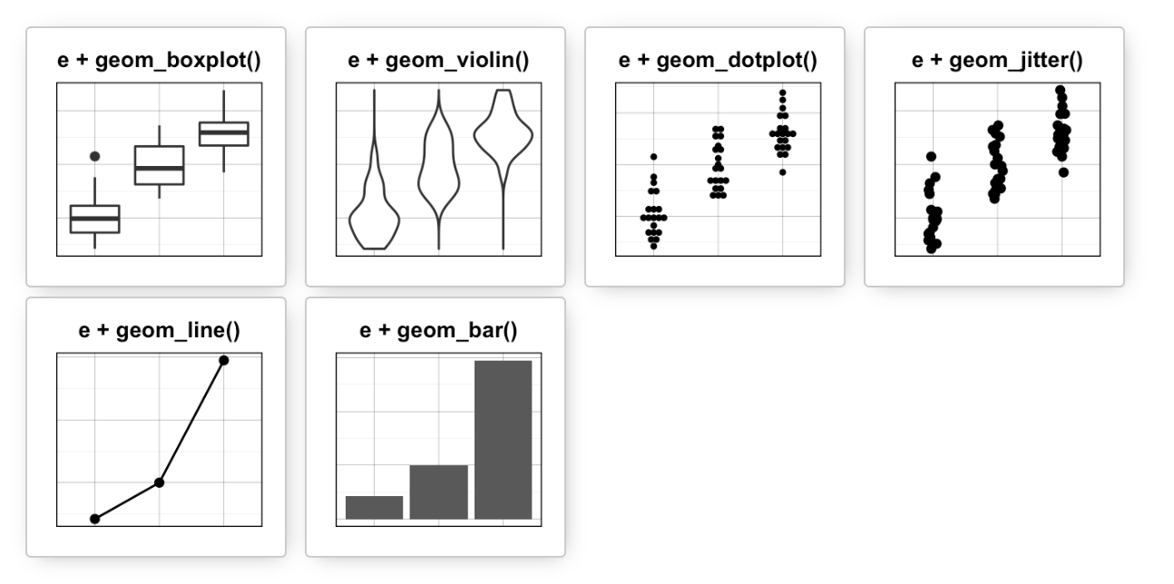
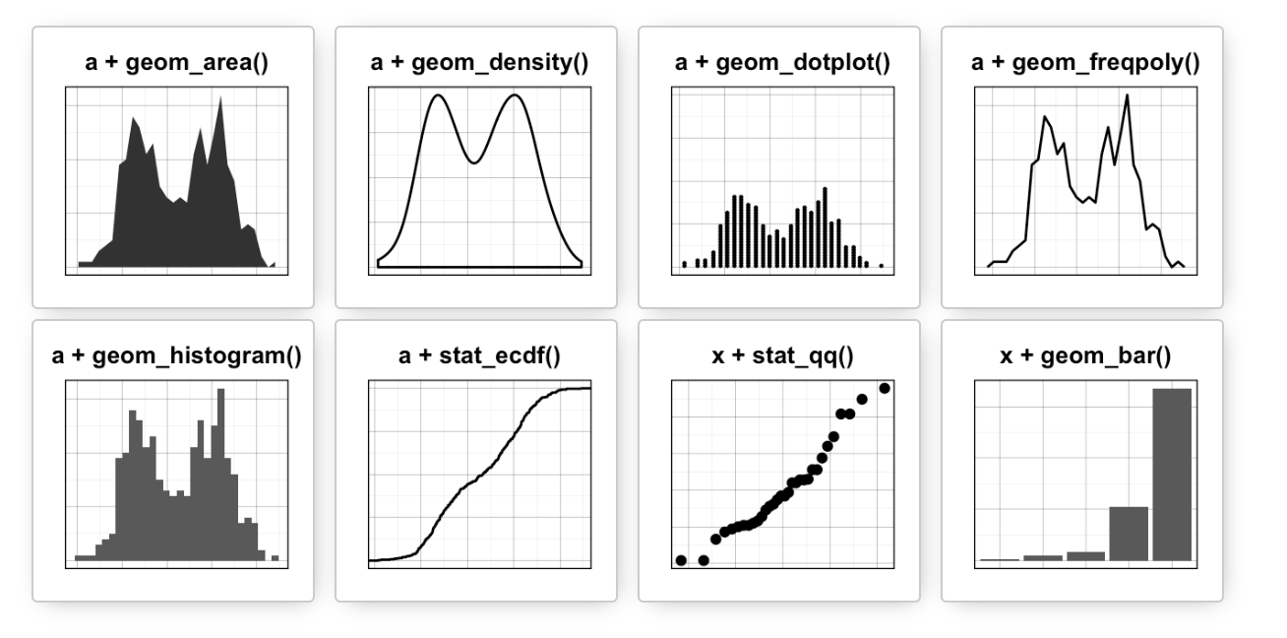
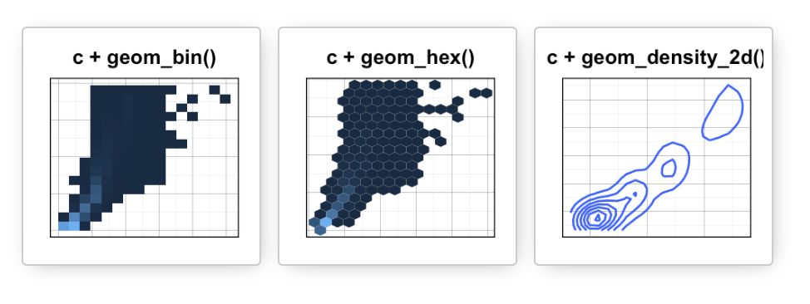
Data
Aesthetics
Geometries
Statistics
Facets
Themes
Exporting

Slide 23
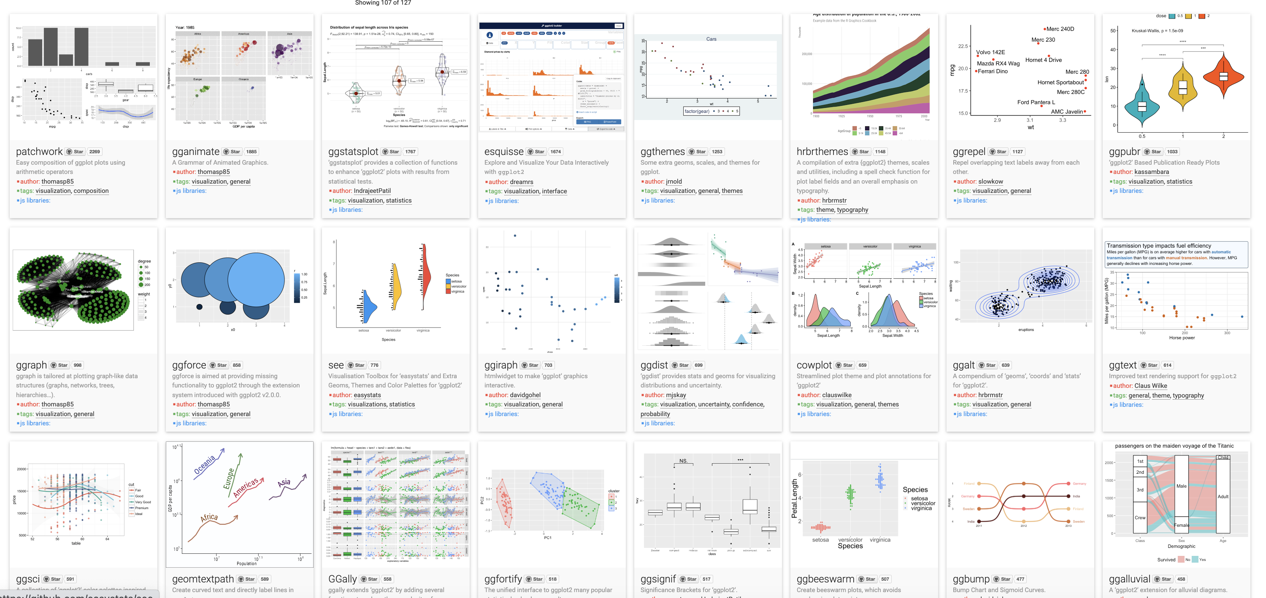
Over 120 ggplot2 extension libraries

Slide 24
ggplot(data = happy, aes(x=GDP, y=happiness))+
geom_point()
“and then…”
dplyr %>% or |>
ggplot +

Slide 25
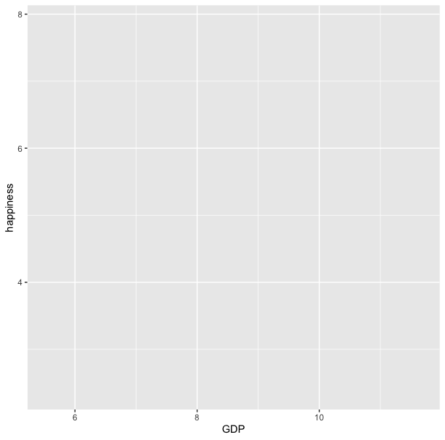
ggplot(data = happy,aes(x=GDP, y=happiness))

Slide 26
ggplot(data = happy, aes(x=GDP, y=happiness))+
geom_point()

Slide 27
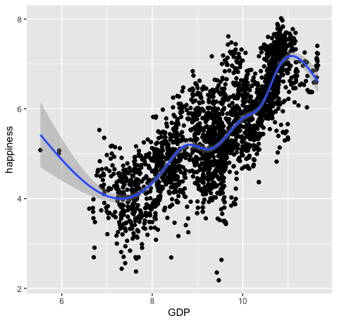
ggplot(data = happy, aes(x=GDP, y=happiness))+
geom_point()+
geom_smooth()

Slide 28
ggplot(data = happy,
mapping = aes(x=GDP, y=happiness))+
geom_point()

Slide 29
ggplot(data = happy,
mapping = aes(x=GDP, y=happiness))+
geom_point()
ggplot(happy, aes(GDP, happiness))+
geom_point()

Slide 30
ggplot(data = happy,
mapping = aes(x=GDP, y=happiness))+
geom_point()
ggplot(happy, aes(GDP, happiness))+
geom_point()
ggplot()+
geom_point(happy,aes(GDP,happiness))
These all produce the same figure

Slide 31
Aesthetics define any data that gets mapped to geometry
(such as color, size, shape, etc.)
Data
Aesthetics
Geometries
Statistics
ggplot(data = yourData,
aes(x = xaxis,y = yaxis))+
geom_point()
Facets
Themes
Exporting
Notes:
method chaining with a +

Slide 32
Aesthetics define any data that gets mapped to geometry
(such as color, size, shape, etc.)
Data
Aesthetics
Geometries
Statistics
ggplot(data = happy,
aes(x = happiness,y = GDP))+
geom_point()
ggplot(data = yourData,
mapping = aes(x = xaxis,y = yaxis))+
geom_point()
Facets
Themes
Exporting
Notes:
method chaining with a +

Slide 34
ggplot(happy, aes(GDP, happiness)) +
geom_point()

Slide 35
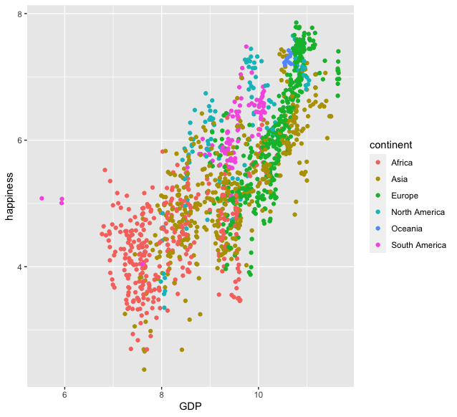
ggplot(happy, aes(GDP, happiness)) +
geom_point(aes(col=continent))

Slide 36
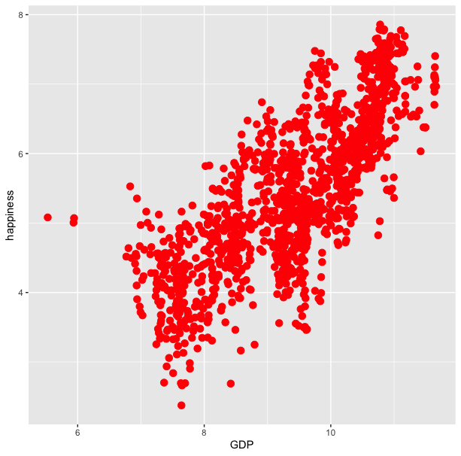
ggplot(happy, aes(GDP, happiness)) +
geom_point(aes(col=continent))
ggplot(happy, aes(GDP, happiness)) +
geom_point(col='red’)

Slide 37
ggplot(happy, aes(GDP, happiness)) +
geom_point()
We can also set conditional formatting.
e.g. Use different colors for points where happiness is > 5

Slide 38
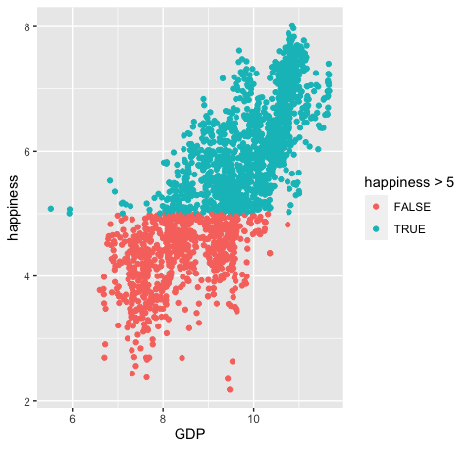
ggplot(happy, aes(GDP, happiness)) +
geom_point()
ggplot(happy, aes(GDP, happiness)) +
geom_point(aes(col=happiness > 5)

Slide 39
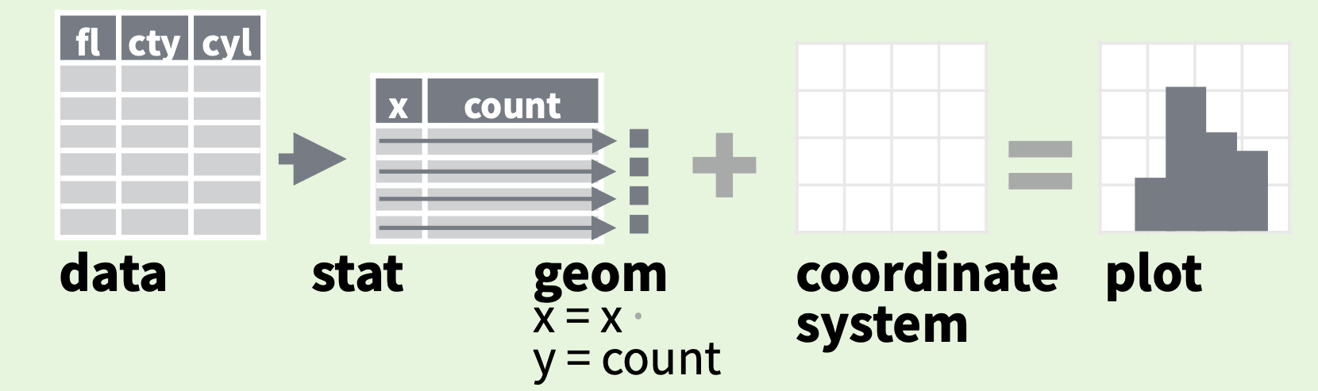
Data
Aesthetics
Geometries
Statistics
Facets
Themes
Exporting

Slide 40
stat
Every geom function specifies a stat
Use a stat function (calls a default geom to make a layer)
Data
Aesthetics
Geometries
Statistics
Facets
Themes
Exporting

Slide 41
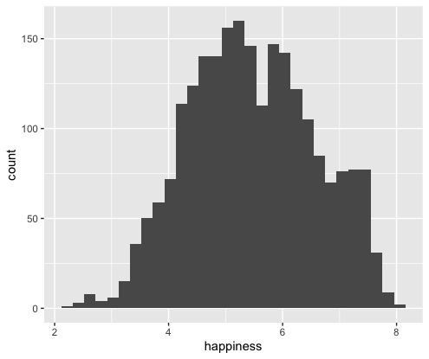
stat
Every geom function specifies a stat
Use a stat function (calls a default geom to make a layer)
ggplot(happy, aes(happiness)) +
geom_histogram()

Slide 42
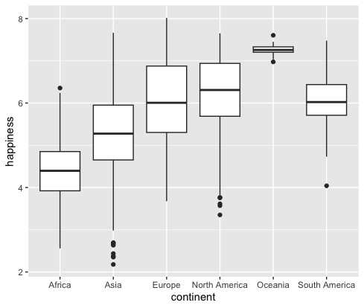
stat
Every geom function specifies a stat
Use a stat function (calls a default geom to make a layer)
ggplot(happy, aes(continent, happiness)) +
geom_boxplot()

Slide 43
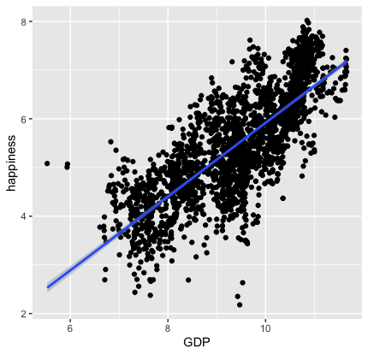
stat
Every geom function specifies a stat
Use a stat function (calls a default geom to make a layer)
ggplot(happy, aes(GDP, happiness)) +
geom_point()+
stat_smooth(method = "lm",
formula = y ~ x)

Slide 44
Data
Aesthetics
Geometries
Statistics
Facets
Themes
Exporting

Slide 45
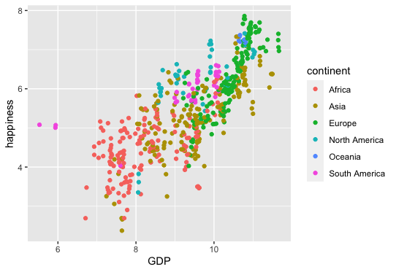
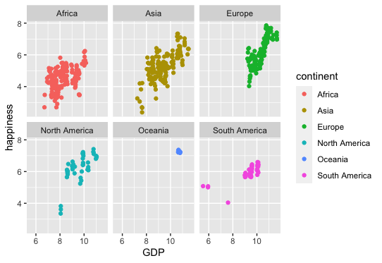
ggplot(happy, aes(x=GDP, y=happiness)) +
geom_point(aes(col=continent))
ggplot(happy, aes(x=GDP, y=happiness)) +
geom_point(aes(col=continent))+
facet_wrap(~continent)

Slide 46
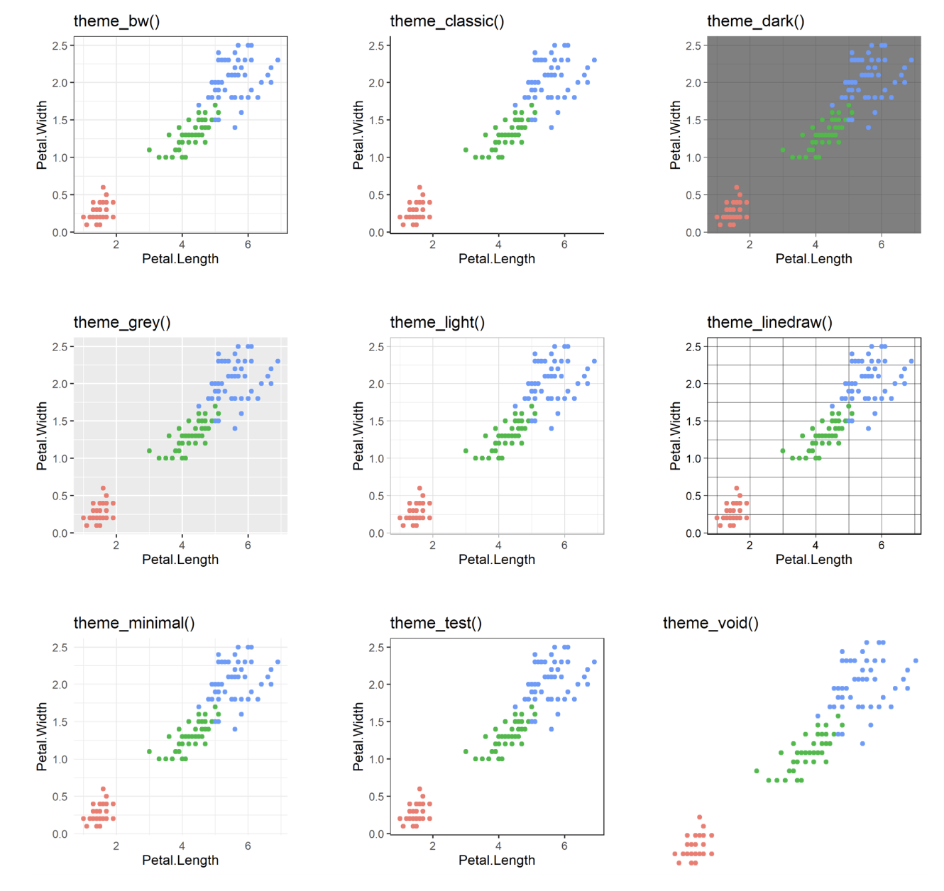
60 preexisting themes
easy to call
Data
Aesthetics
Geometries
Statistics
Facets
Themes
Exporting

Slide 47
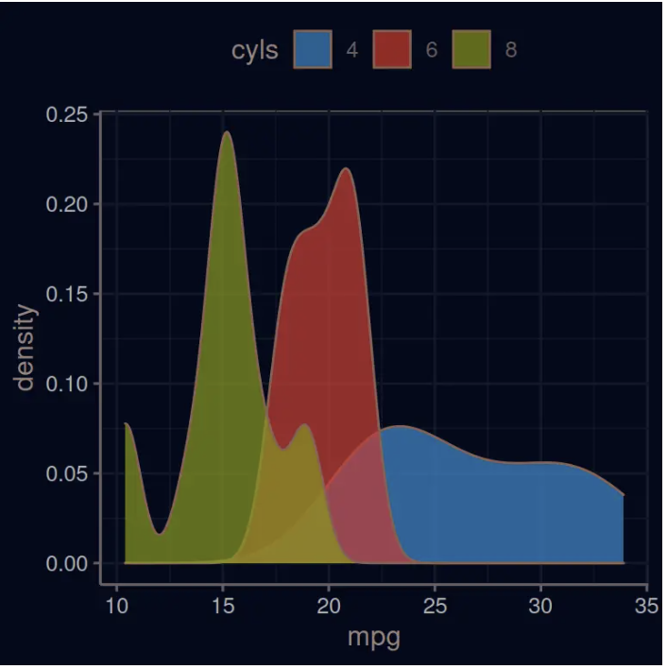
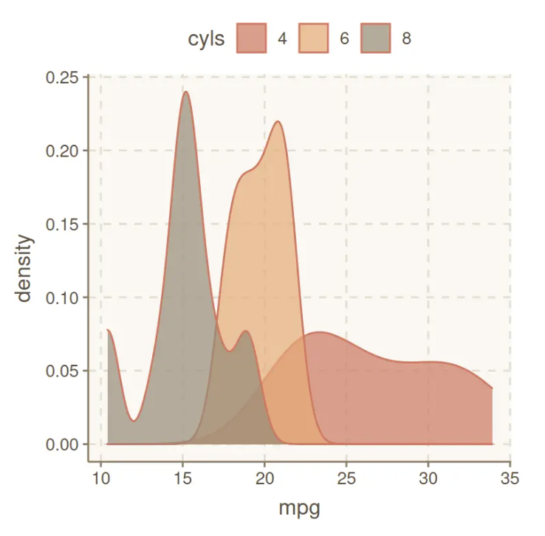
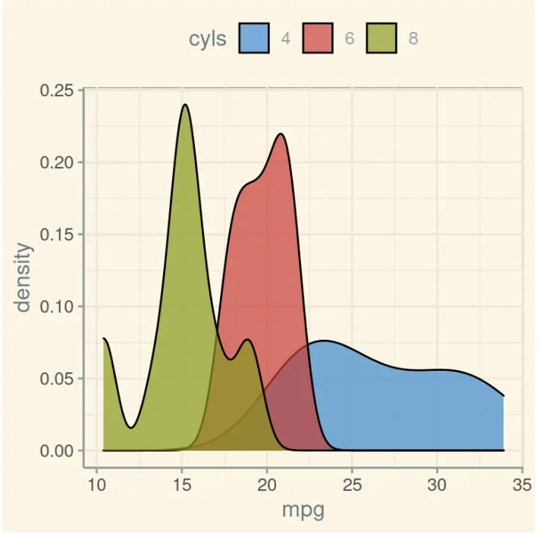
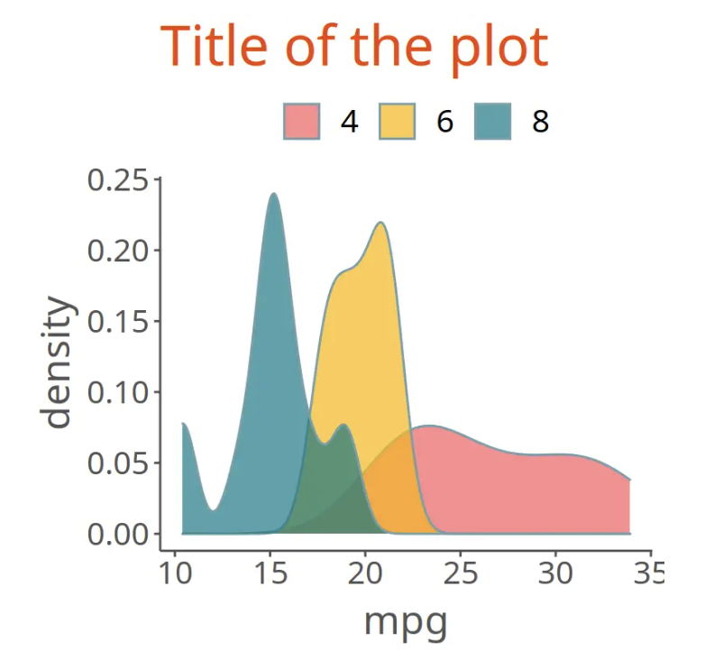
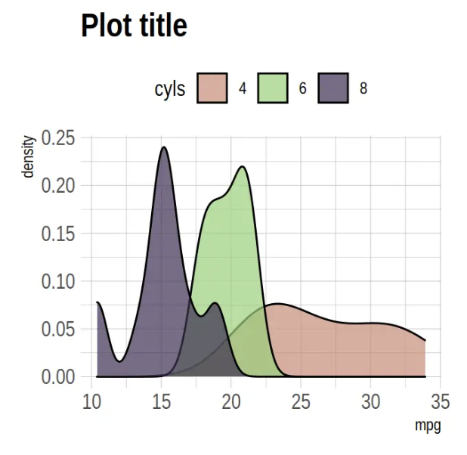
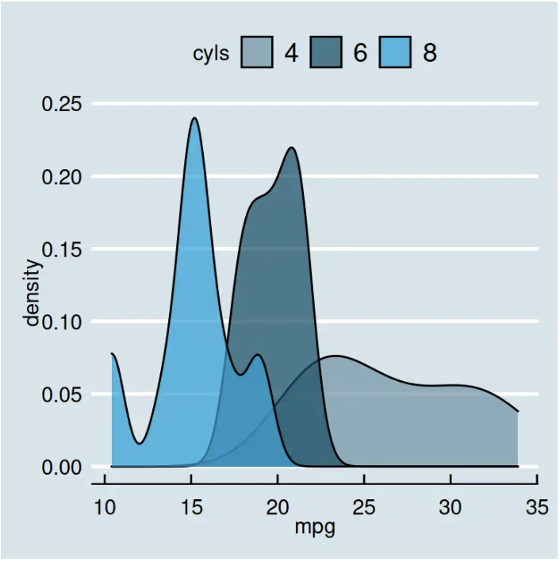
Over 60 pre-existing themes
Data
Aesthetics
Geometries
Statistics
Facets
Themes
Exporting
https://r-charts.com/ggplot2/themes/

Slide 48
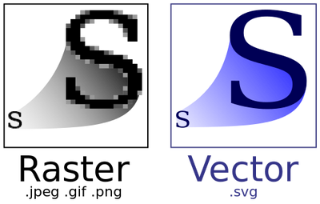
Data
Aesthetics
Geometries
Statistics
Facets
Themes
Exporting

Slide 49
Lets give it a try

